Slide 1
COAS 3rd Year Review
Faculty: Allison Kwesell, Chelsea LeNoble
Faculty Department Chairs: Marie Lathers, Donna Roberts
3rd Year Review Committee: Tanya Corbin, Karen Keene, John Griffith

Slide 2
3rd Year Review Faculty Handbook Part IV: Faculty Tenure
Designed to help P and T Candidates
Develop package
Get feedback on readiness at the “halfway point” as Assistant Professors
Make any needed adjustments

Slide 3
Overview for Faculty Members
3rd Year Review Process
3rd Year Review Schedule
Q and A on Electronic P and T system
Expected Outcomes
More on Promotion and Tenure Process
Appropriate Guidance
Requirements for Tenure and Promotion
P and T Schedule

Slide 4

Review Committee Procedures Source Link Faculty Handbook Part IV: Faculty Tenure
Notify faculty of impending review
Discuss process with Department chairs
Set deadlines for package completion and review
Communicate schedule to faculty members
Schedule meetings as desired to review provided material
Committee will publish 3 reports
Faculty member
Committee meets with each member
College Dean
CAO
Notes:
Per the Faculty Handbook, the 3rd Year Review will progress as follows:
Review Committee procedures
• Step One: The Review Committee will inform the member being reviewed of the impending review and will request that the member being reviewed provide the committee with all appropriate documentation, in the form and sequence detailed in the Faculty Handbook for tenure packages. The Review Committee may also obtain pertinent information, as necessary, from the faculty member’s Department Chair, College Dean, and other University academic and administrative personnel.
• Step Two: The Review Committee will schedule meetings as desired to review the provided material. These meetings may consist of face-to-face committee meetings, electronic meetings and, if deemed appropriate or desired by the committee, a personal meeting with the member being reviewed.
• Step Three: The Review Committee will, after due deliberation, provide the following reports. These reports must be completed no later than the end of the reviewed faculty member’s third year of tenure track employment with the University.
• A written report to the reviewed faculty member containing recommendations as to actions the faculty member should take to continue toward the goal of achieving tenure. This written report may be accompanied by a face-to-face discussion with the reviewed member. Should there be a face-to-face meeting it should include all members of the committee to decrease the possibility of a distorted message.
• A written report to the College Dean and appropriate Department Chair containing the committee’s opinion as to the faculty member’s progress toward achieving tenure status, recommendations as to actions the faculty member should take to continue toward the goal of achieving tenure, and recommendations as to actions the College Dean and/or Department Chair should take to enhance the reviewed faculty member’s opportunity for selection to tenure status.
• A written report to the CAO stating only that the review has been held and that appropriate recommendations have been delivered to the faculty member being reviewed and the applicable College Dean and Department Chair.

Slide 5
3rd Year Review Schedule Based on Faculty Handbook Part IV Faculty Promotions P and T Milestones
By Mid September | Meet with faculty members, advise on process and timeline | Faculty prepare and share preliminary package
1 Oct | Faculty shares preliminary package to Department Chair to review | Department Chair reviews preliminary package
1 Nov | Department Chair provides feedback to faculty member | Faculty makes needed changes to package
1 Dec | Faculty member shares “final” package with Department chair | After final review, faculty submits package to 3 Year Review Committee
15 Jan | 3rd year review committee reviews package | Draft letter to each faculty member
15 Feb | 3rd Year Review Committee meets with faculty, completes Faculty, Dean and CAO letters | Committee also meets with Dept Chair or Dean as needed
Notes:
Although the start date may be different, duration between steps are similar to P and T schedule

Slide 6
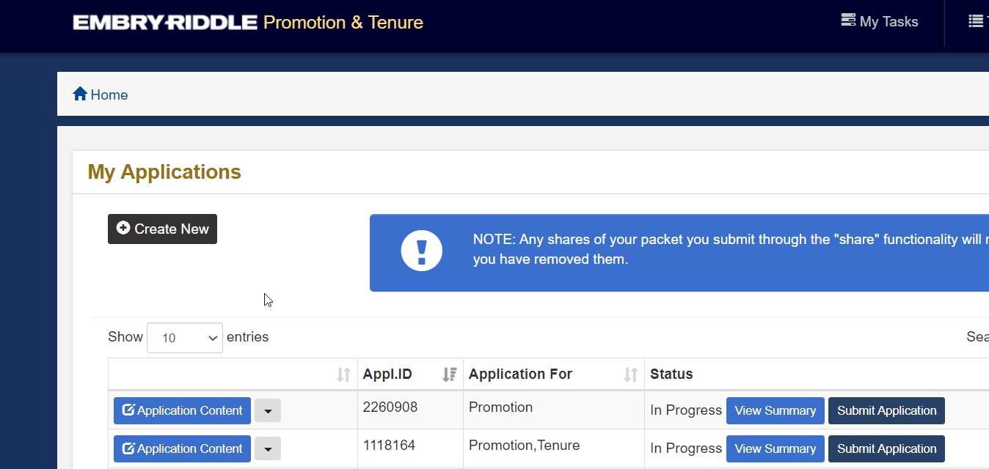
Questions on E- P and T Platform

Slide 7
Expected Outcomes for Faculty Members Faculty Handbook Part IV: Faculty Tenure
Foundation for Promotion and Tenure Package
Better understanding of process
Gain feedback from:
Department Chair
3 Year Review Committee (verbal and written)
Dean
Use feedback to inform:
Performance plans
Research agenda
Service and Teaching goals
Good idea of where they stand and what needs to be done to earn promotion and tenure

Slide 8
Tenure Process Source Link Faculty Handbook Part I Tenure Source Link Faculty Handbook Part I Min time for promotion Source Link Faculty Handbook Part IV: Faculty Tenure
Guided by Faculty Hanboks Parts I and IV and College of Arts and Sciences Guidelines and Criteria for Tenure and Promotion to Associate Professor (1 Aug 2021)
Timeline
Hired or assigned as Tenure Track
3rd Year Review
Apply for Tenure in 5th or 6th year
Awarded first Tenure contract in 6th or 7th year

Slide 9
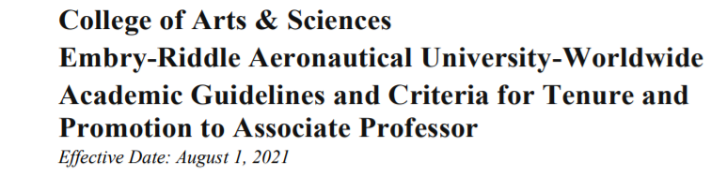
Guidance Source Link Faculty Handbook Part I Tenure Source Link Faculty Handbook Part I Min time for promotion Source Link Faculty Handbook Part IV Faculty Promotions Source Link Faculty Handbook Part IV: Faculty Tenure Source Link : COAS Promotion and Tenure Policy
The selection process for the P&T Committee of the College is detailed in the Faculty Handbook, Part IV, Section 9.3.2. Additionally, the following guidelines apply:
In a given academic year, the COAS P&T Committee will conduct reviews for all portfolios, both for tenure and promotion to Associate Professor and third-year review.
Department chairs are not eligible to serve on the COAS P&T Committee during an academic year in which a candidate from the Chair’s department is being considered for tenure and promotion to Associate Professor or third-year review.

Slide 10
Requirements Overview for Tenure and Promotion Source Link : COAS Promotion and Tenure Policy
Teaching Effectiveness
Annual evaluations (All)
Student evaluations (All)
Peer observations (5)
Additional evidence of teaching effectiveness
Scholarly Activity
Peer reviewed publications (5)
Presentations at refereed regional, national or international conferences (5)
Submitted internal or external grant proposal (1)
Service
Committee: Member or Chair - University, Campus, College or Dept
Manage academic programs
Peer review (faculty observations)
Moderating panel presentations
Developing and organizing professional conferences
“Life and activities of the department” as requested by Dept. Chair
Holding office in professional organization
Additional examples as described in COAS Promotion and Tenure Policy
Additional examples as described in COAS Promotion and Tenure Policy
Additional examples as described in COAS Promotion and Tenure Policy

Slide 11
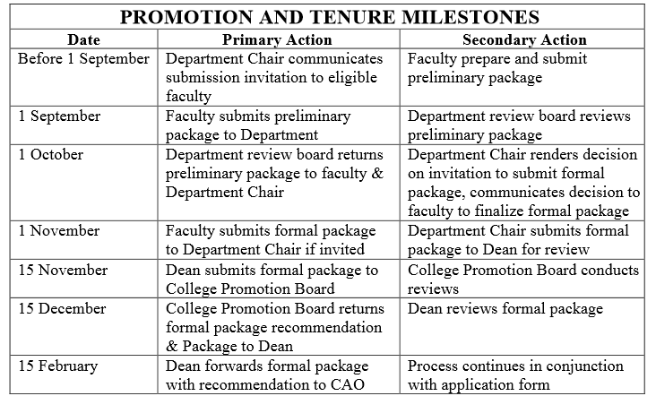
P and T Schedule Source Link Faculty Handbook Part IV Faculty Promotions

Slide 12
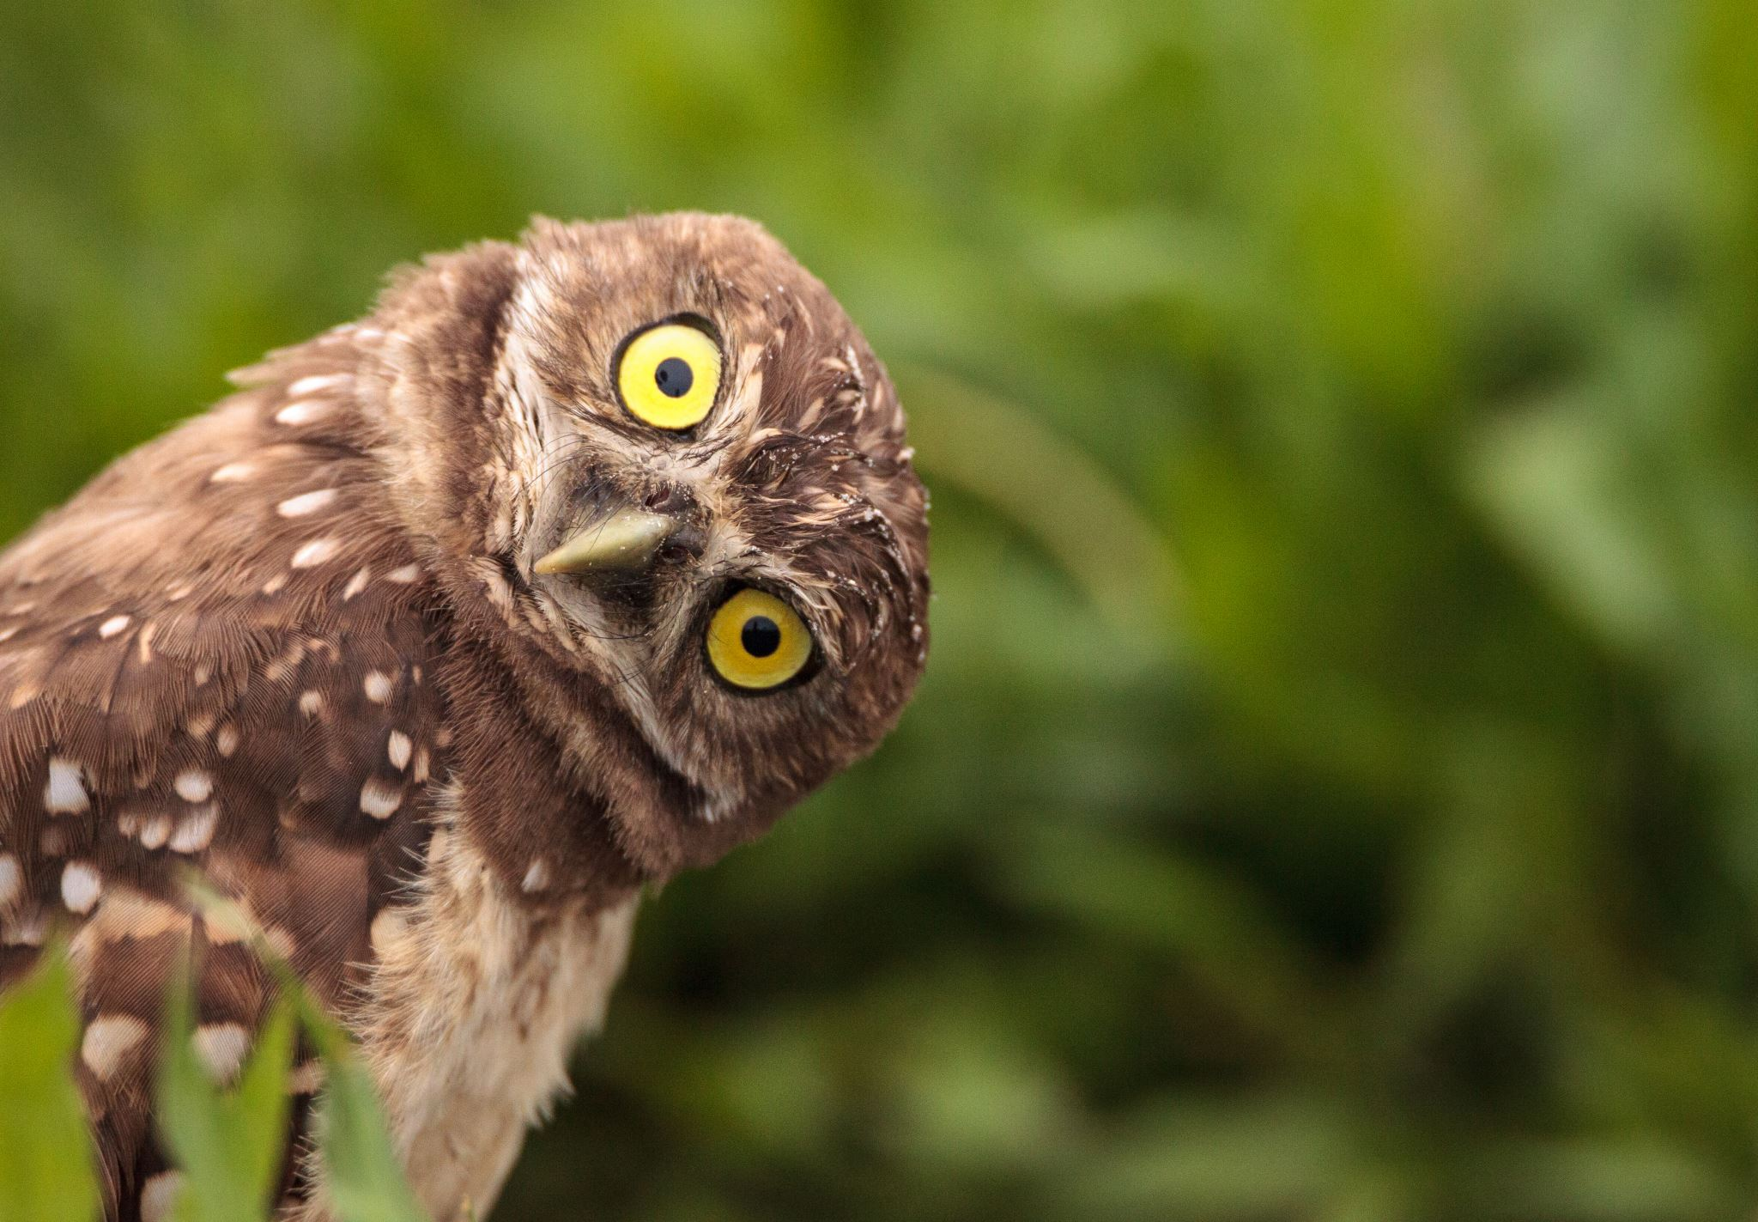
Questions

